Slide 1
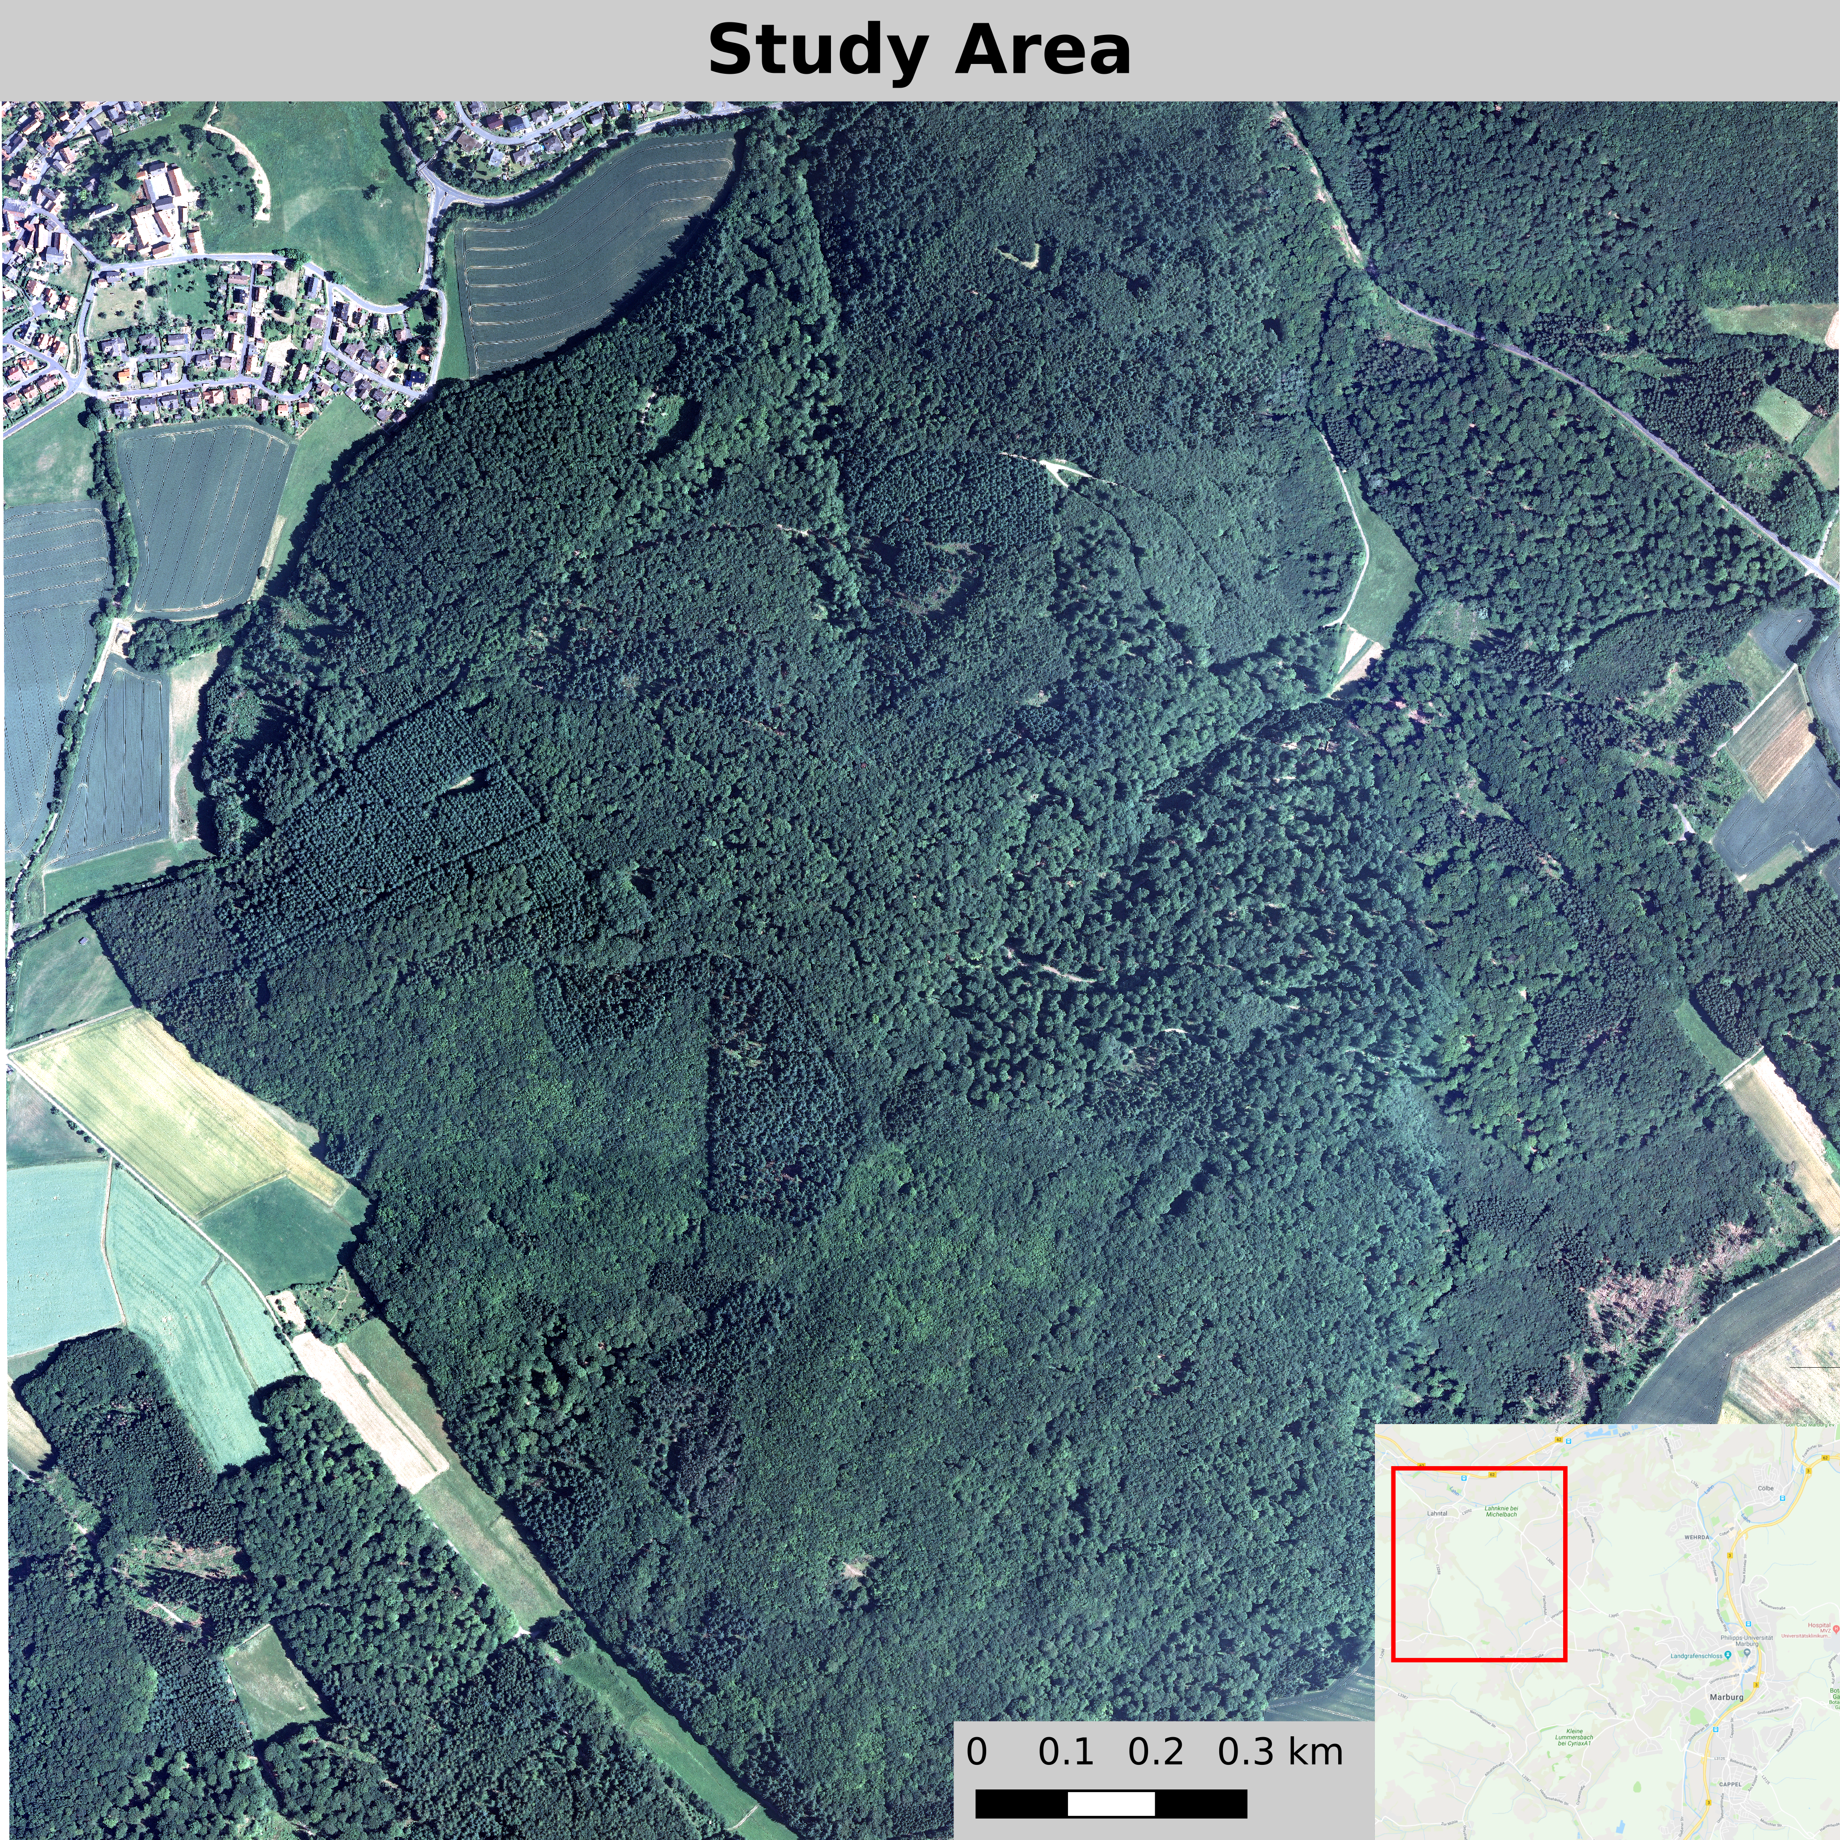
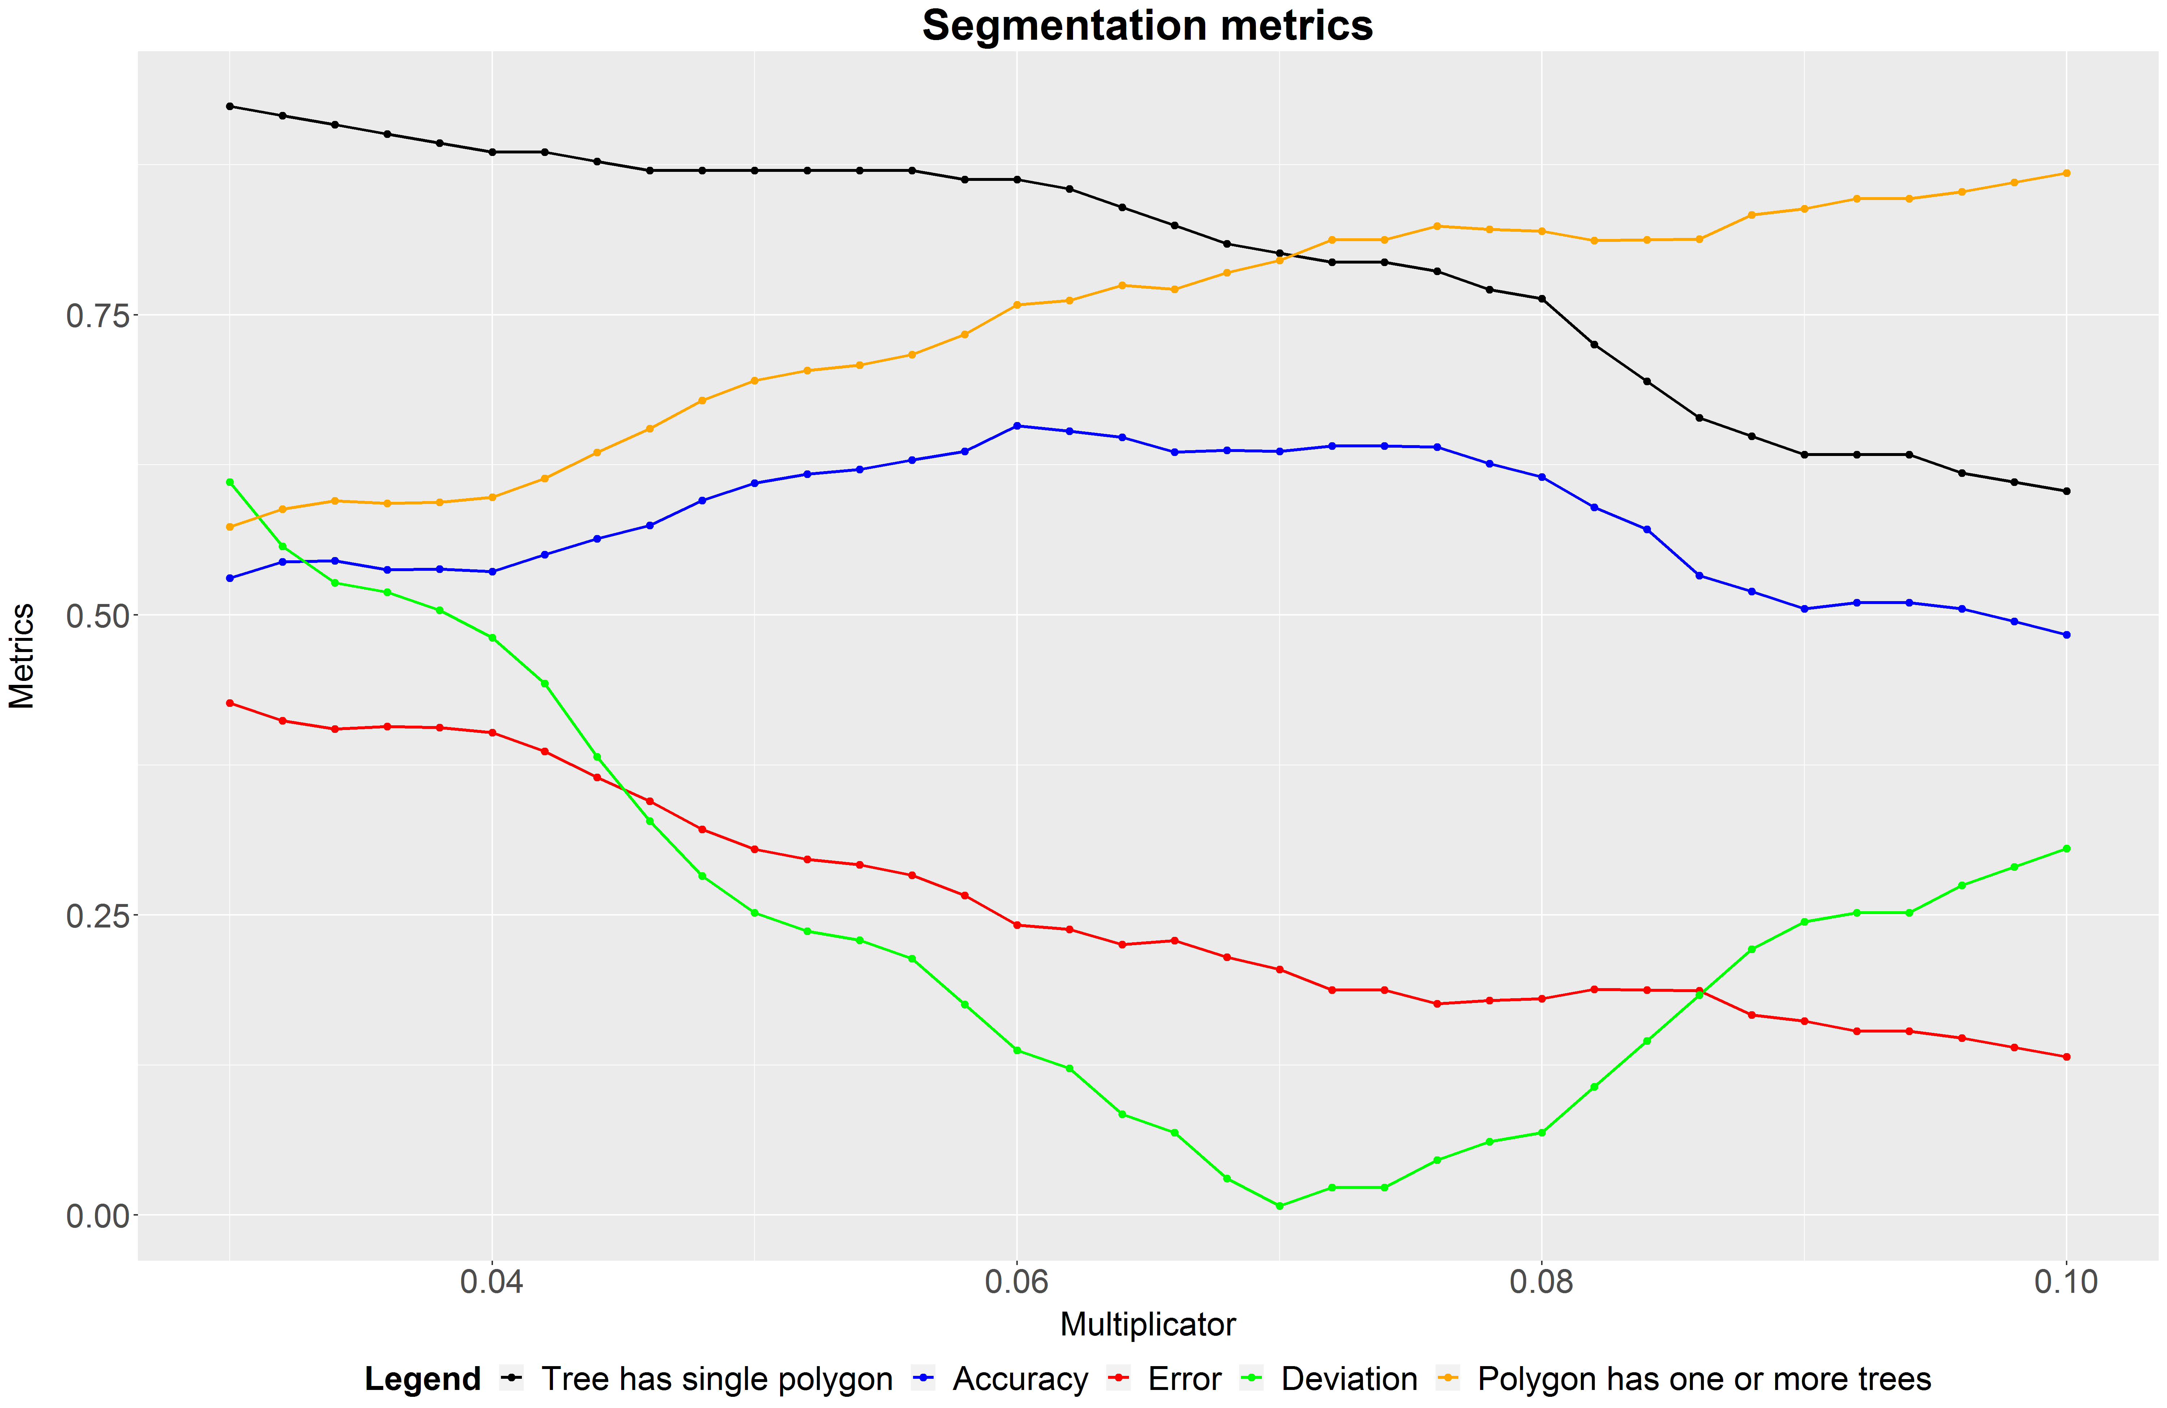
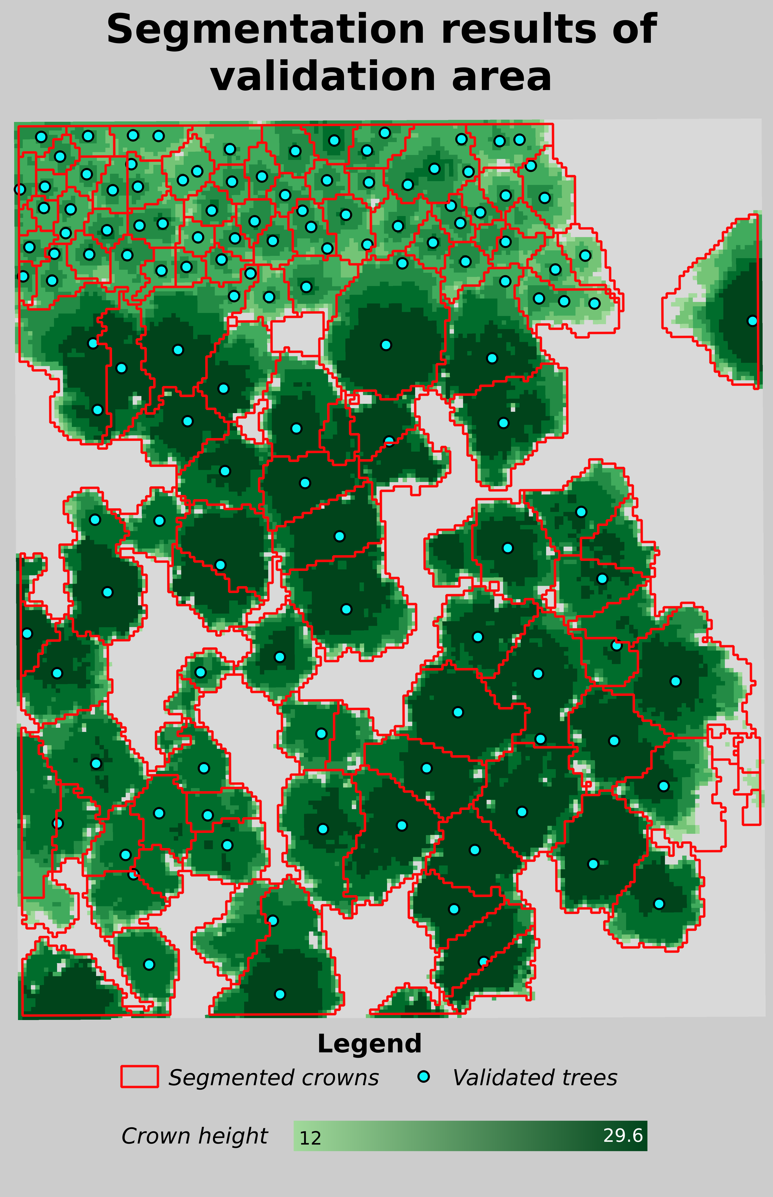
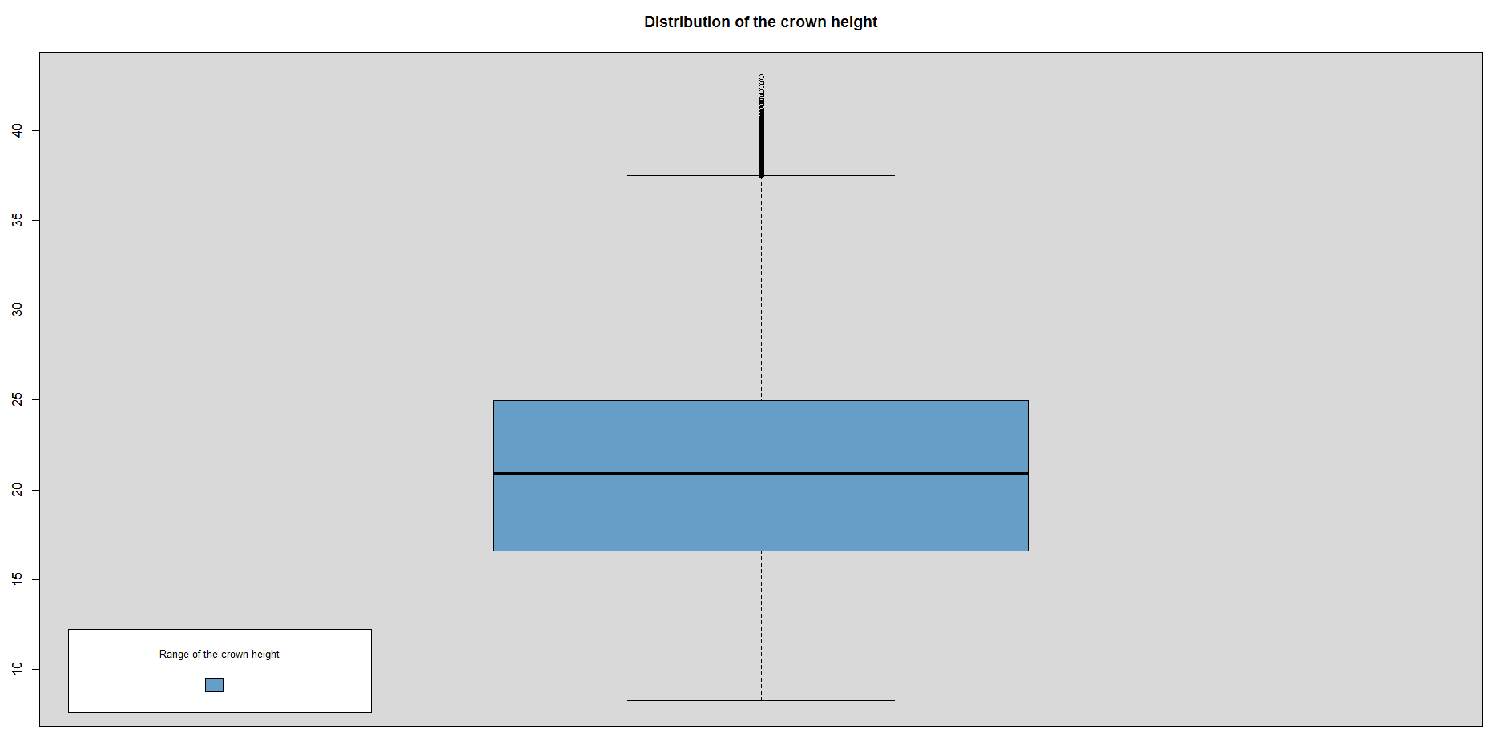
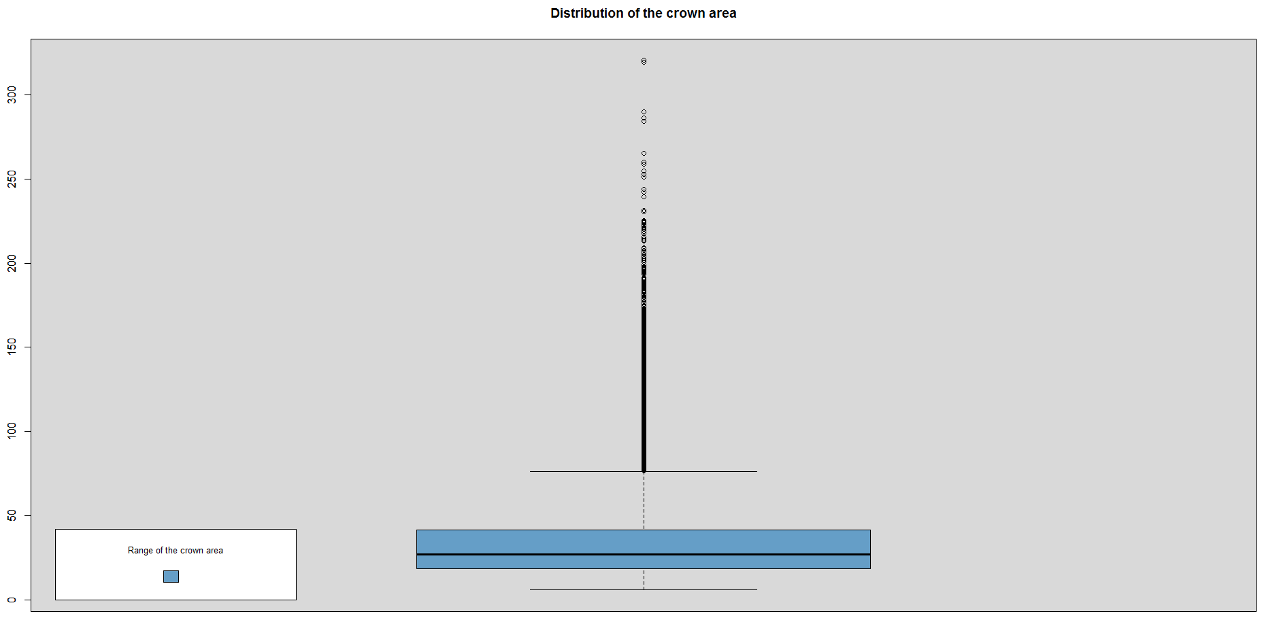
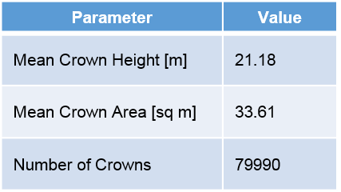

Project I: Tree Crown Segmentation
Names: Sarah Brüning, Tobias Koch, Marvin Müsgen, Eike Schott, Frauke von den Driesch
Umweltinformatik | Philipps-Universität Marburg
Background
The study area is located at the Marburg Open Forest which lies southeast of Caldern in the west of Marburg. In the large-scale context it belongs to the low mountain range of western central Hessen. The region itself is referred to as the “Gladenbacher Bergland” and can be characterized as a diverse biological and cultural landscape (Nowak & Wedra, 1988). The altitude displays a dynamic structure of mountain ranges and different valley shapes. Geologically, it can be allocated to the Rhenish Slate Mountains with dominance of rocks from new red sandstone and carboniferous. The natural forest vegetation of the study area can be classified either as a wood-rush and beech population or a woodruff and beech population.
The first step to analyze the forest structure and tree competition in the Marburg Open Forest is to obtain reliable information on the amount, distribution and size of the individual trees in this area. Regarding this goal, the method of tree crown segmentation using LiDAR data can be seen as an essential application. In general, the use of LiDAR datasets provides the opportunity for detailed studies of forest condition and dynamics (Barnes et al., 2017). By extracting individual tree parameters like count of tree, total height or crown diameter and width the accuracy of forest inventory can be increased (Reutebuch et al., 2005). As a result, the amount of fieldwork required for forest inventory is not only reduced but also the assessment of forest damage is enabled (Chen et al., 2006).
Figure 1: Overview of the study area in Marburg, Caldern.
Choosing Algorithm
Applying Filter
Choosing Forest Tools Algorithm due to lowest deviation from reality
Applying Algorithm
Validation
Choosing validation area with diverse forest structure
Applying Algorithm to the whole study area
Segmentation
Manual validation by setting trunk positions
Modifying Algorithm
Improving algorithm results by modifying win function
Computing CHM
Computing DTM and DSM
Creating Digital Terrain Model (DTM) and Digital Surface Model (DSM) from LiDAR data
Creating Canopy Height Model (CHM) by subtracting DTM from DSM
Applying 3x3 Mean Filter to CHM
Standard Forest Tools Win Function
Modified Forest Tools Win Function
Figure 2: Algorithm performance with changing moving window.
Name | Tree has single Polygon | Accuracy | Error | Deviation | Polygon has one or more Trees
Formula | $$\frac{Number of trees with their own allocated polygon}{Number of counted trees}$$ | $$\frac{Number of polygons containing exactly one tree}{Number of all created polygons}$$ | $$\frac{Number of polygons that do not contain a tree}{Number of all created polygons}$$ | $$\frac{\begin{aligned}\text{|}\text{Number} \text{of} \text{all} \text{created} \text{polygons}\text{ – } \\ \text{Number} \text{of} \text{counted} \text{trees} \text{|}\end{aligned}}{Number of counted trees}$$ | $$\frac{\begin{aligned}(Polygons containing exactly one tree+ \\ Polygons including more than one tree)\end{aligned}}{Number of all created polygons}$$
Table 1:Used metrics to measure model performance.
Segmentation
Segmentation Statistics
Conclusion and outlook
Distribution of crown height
In this project part the segmentation of tree crowns was done using the ForestTools algorithm by Andrew Plowright (Plowright, 2018). Other segmentation algorithms e.g. the ITC Segment algorithm by Michele Dalponte were also taken under consideration (Dalponte, 2018). The outcome of this project part is a shapefile containing detailed information on several crown properties such as height and area. Finding the ideal algorithm parameters was done by testing several combinations and choosing the best suited for the given forest situation.
Results are indicating an accuracy of 65.116% while the error rate is at 18.604%.
Future project parts are including the prediction of tree species using this segmentation as well as other indicators.
Range of crown height [m]
Figure 4: Boxplot of the calculated crown height.
Distribution of crown area
Range of crown area [sq m]
Figure 5: Boxplot of the calculated crown area.
Literature
Barnes, C., Balzter, H., Barrett, K., Eddy, J., Milner, S., Suárez, J. C. (2017): Individual Tree Crown Delineation from Airborne Laser Scanning for Diseased Larch Forest Stands. In: Remote Sensing. Vol. 9, No. 3. 1 – 20.
Nowak, B., Wedra, C. (1988): Beiträge zur Kenntnis der Vegetation des Galdenbacher Berglands. I. Die Ackerunkrautgesellschaften. In: Philippia. Vol. 6, No. 1. 38 – 80.
Reutebuch, S., Andersen, H.-E., McGaughey, R. J. (2005): Light Detection and Ranging (LiDAR): An Emerging Tool for Multiple Resource Inventory. In: Journal of Forestry. Vol. 103, No. 6. 286 – 292.
Chen, Q., Baldocchi, D., Gong, P., Kelly, M. (2006): Isolating Individual Tree in a Savanna Woodland Using Small Footprint LiDAR Data. In: Photogrammetric Engineering & Remote Sensing. Vol. 72, No. 8. 923 – 932.
Figure 3: Resulting crown segmentation on the validation area.
Table 2: Summary of crown polygon statistics.

